Slide 1
Surface-Atmosphere Exchange Modeling
Rick D. Saylor
NOAA/Air Resources Laboratory
Atmospheric Turbulence and Diffusion Division
June 22, 2016

Slide 2
Surface-Atmosphere Exchange
Exchange of water vapor, energy and trace species (gas and aerosol phases) between the atmosphere and the Earth’s surface.
Weather, climate and air quality
Notes:
Surface energy balance and evapotranspiration drive atmospheric dynamics (meteorology and climate) and are key to understanding the water cycle.
Exchange (emission and/or uptake) of trace gaseous species (e. g., CH₄, N₂O, NO, BVOCs, NH₃) critical for understanding various issues in climate, air quality and ecosystem dynamics.
Interactions between the physics and chemistry of the atmosphere and the biology and ecology of the biosphere are vital for successful predictive models.
Deposition (both wet and dry) of gases and particles is the major removal mechanism for many atmospheric trace species and may alter chemical balances of sensitive ecosystems.

Slide 3
Relevance:
Surface-Atmosphere Exchange Modeling
NOAA’s Five-Year (2013-2017) Research & Development Plan
  Weather-Ready Nation
  Healthy people and communities due to improved air and water quality services
  Science and Technology
  A holistic understanding of the Earth system through research
  Accurate and reliable data from sustained and integrated Earth observing systems
  An integrated environmental modeling system
  Climate Adaptation and Mitigation
  Improved scientific understanding of the changing climate system and its impacts
Notes:
Surface-atmosphere exchange modeling is directly relevant to NOAA’s mission since surface-atmosphere exchange processes affect weather, climate and air quality.

Slide 4
Seminal Surface-Atmosphere Exchange Research from ATDD
Hicks, Baldocchi, Meyers, Hosker and Matt (1987) A preliminary multiple resistance routine for deriving dry deposition velocities from measured quantities, Water Air Soil Poll., 36, 311-330.
Meyers (1987) The sensitivity of modeled SO₂ fluxes and profiles to stomatal and boundary layer resistances, Water Air Soil Poll., 35, 261-278.
Baldocchi, Hicks, and Camara (1987) A canopy stomatal resistance model for gaseous deposition to vegetated surfaces, Atmos. Environ., 21, 91-101.
Meyers and Baldocchi (1988) A comparison of models for deriving dry deposition fluxes of O₃ and SO₂ to a forest canopy, Tellus, 40B, 270-284.
Baldocchi (1988) A multi-layer model for estimating sulfur dioxide deposition to a deciduous oak forest canopy, Atmos. Environ., 22, 869-884.
Meyers, Huebert and Hicks (1989) HNO₃ deposition to a deciduous forest, Boundary-Layer Meteorol., 49, 395-410.
Meyers, Finkelstein, Clarke, Ellestad, and Sims (1998) A multilayer model for inferring dry deposition using standard meteorological measurements, J. Geophys. Res., 103, D17, 22645-22661.
Wesely and Hicks (2000) A review of the current status of knowledge on dry deposition, Atmos. Environ., 34, 2261-2282.
Notes:
The Atmospheric Turbulence and Diffusion Division (ATDD) of ARL, in Oak Ridge, TN, has a long history of surface-atmosphere exchange research, dating from the 1980-90’s as part of the National Acid Precipitation Assessment Program (NAPAP). In particular, much of our current understanding of dry deposition stems from research performed at ATDD or in collaboration with ATDD scientists. The work described in this presentation is a continuation of that legacy, taking advantage of the expertise in surface-atmosphere exchange still resident at the laboratory.

Slide 5
Topics in Surface-Atmosphere Exchange Science
Magnitude and identity of biogenic hydrocarbon compounds emitted from vegetation.
  Park et al. (2013); Chan et al., (2013); Park et al. (2014)
Chemical processing of biogenics within and above vegetative canopies.
  - Fuentes et al. (2007); Bryan et al. (2012); Saylor (2013)
  - Wolfe et al. (2016), (2014) & (2010); Hu et al. (2013)
Bi-directional exchange
  - NH₃ Nemitz et al. (2001); Pleim et al. (2013)
  - BVOCs Niinemets et al. (2014); Park et al. (2014); Karl et al. (2010)
  - particles Rannik et al. (2016); Farmer et al. (2013); Pryor et al. (2013)
Notes:
- Park et al. (2013) Active atmosphere-ecosystem exchange of the vast majority of detected volatile organic compounds, Science, 341, 643-647.
- Chan et al. (2013) Detailed chemical characterization of Unresolved Complex Mixtures (UCM) in atmospheric organics: Insights into emission sources, atmospheric processing and secondary organic aerosol formation, Journal of Geophysical Research, 118, doi:10.1002/jgrd505332013.
- Park et al. (2014) Biogenic volatile organic compound emissions during BEARPEX 2009 measured by eddy covariance and flux-gradient similarity methods, Atmospheric Chemistry and Physics, 14, 231-244.

Slide 6
Topics in Surface-Atmosphere Exchange Science
Magnitude and identity of biogenic hydrocarbon compounds emitted from vegetation.
  Park et al. (2013); Chan et al., (2013); Park et al. (2014)
Chemical processing of biogenics within and above vegetative canopies.
  - Fuentes et al. (2007); Bryan et al. (2012); Saylor (2013)
  - Wolfe et al. (2016), (2014) & (2011); Hu et al. (2015)
Bi-directional exchange
  - NH₃ Nemitz et al. (2001); Pleim et al. (2013)
  - BVOCs Niinemets et al. (2014); Park et al. (2014); Karl et al. (2010)
  - particles Rannik et al. (2016); Farmer et al. (2013); Pryor et al. (2013)
Notes:
- Fuentes et al. (2007) Biogenic hydrocarbon chemistry within and above a mixed deciduous forest, Journal of Atmospheric Chemistry, 56, 165-185.
- Bryan et al. (2012) In-canopy gas-phase chemistry during CABINEX 2009: sensitivity of a 1-D canopy model to vertical mixing and isoprene chemistry, Atmospheric Chemistry and Physics, 12, 8829-8849.
- Saylor (2013) The Atmospheric Chemistry and Canopy Exchange Simulation System (ACCESS): model description and application to a temperate deciduous forest canopy, 13, 693-715.
- Wolfe et al. (2011) The Chemistry of Atmosphere-Forest Exchange (CAFÉ) model – Part 2: Application to BEARPEX-2007 observations, Atmospheric Chemistry and Physics, 11, 1269-1294.
- Wolfe et al. (2014) Missing peroxy radical sources within a summertime ponderosa pine forest, Atmospheric Physics and Chemistry, 14, 4715-4732.
- Wolfe et al. (2016) Formaldehyde production from isoprene oxidation across NOx regimes, Atmospheric Physics and Chemistry, 16, 2597-2610.
- Hu et al. (2015) Chemical processing within and above a loblolly pine forest in North Carolina, USA, Journal of Atmospheric Chemistry, 72, 235-259.

Slide 7
Topics in Surface-Atmosphere Exchange Science
Magnitude and identity of biogenic hydrocarbon compounds emitted from vegetation.
  Park et al. (2013); Chan et al., (2013); Park et al. (2014)
Chemical processing of biogenics within and above vegetative canopies.
  - Fuentes et al. (2007); Bryan et al. (2012); Saylor (2013)
  - Wolfe et al. (2016), (2014) & (2010); Hu et al. (2013)
Bi-directional exchange
  - NH₃ Nemitz et al. (2001); Pleim et al. (2013)
  - BVOCs Niinemets et al. (2014); Park et al. (2013); Karl et al. (2010)
  - particles Rannik et al. (2016); Farmer et al. (2013); Pryor et al. (2013)
Notes:
Nemitz et al. (2001) A two-layer canopy compensation point model for describing bi-directional biosphere-atmosphere exchange of ammonia, Q. J. Royal Meteorological Society, 127, 815-833.
Pleim et al. (2013) Development and evaluation of an ammonia bidirectional flux parameterization for air quality models, Journal of Geophysical Research, 118, doi:10.1002/jgrd.50262.
Niinemets et al. (2014) Bidirectional exchange of biogenic volatiles with vegetation: emission sources, reactions, breakdown and deposition, Plant, Cell and Environment, 37, 1790-1809.
Park et al. (2013) Active atmosphere-ecosystem exchange of the vast majority of detected volatile organic compounds, Science, 341, 643-647.
Karl et al. (2010) Efficient atmospheric cleansing of oxidized organic trace gases by vegetation, Science, 330, 816-819.
Rannik et al. (2016) Aerosol dynamics within and above forest in relation to turbulent transport and dry deposition, Atmospheric Chemistry and Physics, 16, 3145-3160.
Farmer et al. (2013) Chemically resolved particle fluxes over tropical and temperate forests, Aerosol Science and Technology, 47, 818-830.
Pryor et al. (2013) Size-resolved particle fluxes and vertical gradients over and in a sparse pine forest, Aerosol and Science and Technology, 47, 1248-1257.

Slide 8
Topics in Surface-Atmosphere Exchange Science
Particle deposition parameterizations
  - Im et al. (2015) AQMEII PM evaluation
        “… simulated dry deposition can lead to substantial differences among the models.”
    - Lee et al. (2013) – global CCN most sensitive to dry deposition
    - Saylor, Baker & Hicks (2015); Hicks et al. (2016)
  - Petroff & Zhang (2010); Pryor et al. (2008); Zhang & Shao (2015)
- Huang et al. (2014); Zhang & He (2014); Kouznetsov & Sofiev (2012)
- Feng (2008); Nho-Kim et al. (2004); Petroff et al. (2009)
Notes:
Im et al. (2015) Evaluation of operational online-coupled regional air quality models over Europe and North America in the context of AQMEII phase 2. Part II: particulate matter, Atmospheric Environment, 115, 421-441.
Lee et al. (2013) The magnitude and causes of uncertainty in global model simulations of cloud condensation nuclei, Atmospheric Chemistry and Physics, 13, 8879-8914.

Slide 9
Topics in Surface-Atmosphere Exchange Science
Particle deposition parameterizations
  - Im et al. (2014) AQMEII PM evaluation
        “… simulated dry deposition can lead to substantial differences among the models.”
    - Lee et al. (2013) – global CCN most sensitive to dry deposition
    - Saylor et al. (2015); Hicks et al. (2016)
  - Petroff & Zhang (2010); Pryor et al. (2008); Zhang & Shao (2014)
- Huang et al. (2014); Zhang & He (2014); Kouznetsov & Sofiev (2012)
- Feng (2008); Nho-Kim et al. (2004); Petroff et al. (2009)
Notes:
Saylor et al. (2015) A Comparison of Particle Dry Deposition Algorithms in Air Quality Models, 17th Community Modeling and Analysis System Annual Conference, Chapel Hill, NC, October 5-7.
Hicks et al. (2016) Dry deposition of particles to canopies – A look back and the road forward, Journal of Geophysical Research, in review.
Petroff & Zhang (2010) Development and validation of a size-resolved particle dry deposition scheme for application in aerosol transport models, Geoscientific Model Development, 3, 753-769.
Pryor et al. (2008) A review of measurement and modelling results of particle atmosphere-surface exchange, Tellus B, 60, 42-75.
Zhang & Shao (2015) A new parameterization of particle dry deposition over rough surfaces, Atmospheric Chemistry and Physics, 14, 12429-12440.
Huang et al. (2014) Particle deposition to forests: An alternative to K-theory, Atmospheric Environment, 94, 593-605.
Zhang and He (2014) Technical Note: An empirical algorithm estimating dry deposition velocity of fine, coarse and giant particles, Atmospheric Chemistry and Physics, 14, 3729-3737.
Kouznetsov and Sofiev (2012) A methodology for evaluation of vertical dispersion and dry deposition of atmospheric aerosols, Journal of Geophysical Research, 117, doi:10.1029/2011JD016366.
Feng (2008) A size-resolved model and a four-mode parameterization of dry deposition of atmospheric aerosols, Journal of Geophysical Research, 113, doi: 10.1029/2007JD009004.
Nho-Kim et al. (2004) Parameterization of size-dependent particle dry deposition velocities for global modeling, Atmospheric Environment, 38, 1933-1942.
Petroff et al. (2009) An extended dry deposition model for aerosols onto broadleaf canopies, Aerosol Science, 40, 218-240.

Slide 10
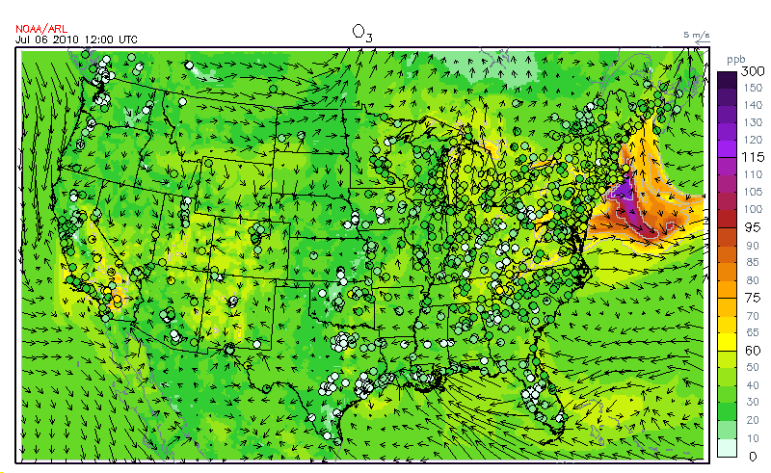
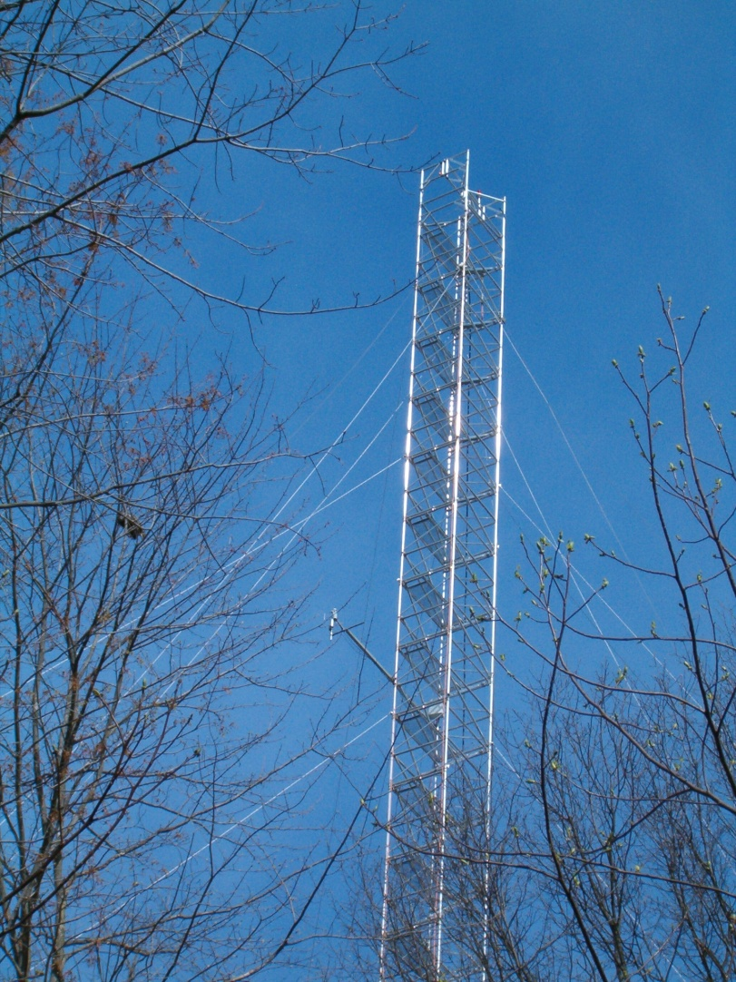
Approach: Surface-Atmosphere Exchange Modeling
Translation of modeling and measurement results to NAQFC
Process modeling of surface-atmosphere interactions
Analysis of trace species concentration and flux measurements
Notes:
Process-level models of surface-atmosphere exchange are developed and, in conjunction with trace species concentration and flux measurements (from either long-term measurement networks or intensive field measurement campaigns) new understanding of surface-atmosphere exchange processes is generated.

Slide 11
Approach: Surface-Atmosphere Exchange Modeling
Translation of modeling and measurement results to NAQFC
Process modeling of surface-atmosphere interactions
Analysis of trace species concentration and flux measurements
Notes:
As new understanding of surface-atmosphere exchange is developed, new inputs, parameterizations, or modules are translated to the air quality modeling community in general and to NOAA’s National Air Quality Forecasting Capability in particular.

Slide 12
Motivating Questions
How well do large-scale models (e.g. CMAQ, WRF-Chem, etc.) simulate the complex small-scale physics and chemistry occurring within and just above vegetative canopies?
How important are these processes for the large-scale prediction of surface O₃ and PM_{2.5}?
Are traditional parameterizations developed for the coarse horizontal resolutions of the 1980’s-90’s (40-60 km) still adequate for modern air quality models with resolutions approaching 1-2 km or less?
Can more accurate parameterizations of emission and deposition be developed by taking advantage of increased computational power?

Slide 13
Motivating Questions
How well do large-scale models (e.g. CMAQ, WRF-Chem, etc.) simulate the complex small-scale physics and chemistry occurring within and just above vegetative canopies?
How important are these processes for the large-scale prediction of surface O₃ and PM_{2.5}?
Are traditional parameterizations developed for the coarse horizontal resolutions of the 1980’s-90’s (40-60 km) still adequate for modern air quality models with resolutions approaching 1-2 km or less?
Can more accurate parameterizations of emission and deposition be developed by taking advantage of increased computational power?

Slide 14
Motivating Questions
How well do large-scale models (e.g. CMAQ, WRF-Chem, etc.) simulate the complex small-scale physics and chemistry occurring within and just above vegetative canopies?
How important are these processes for the large-scale prediction of surface O₃ and PM_{2.5}?
Are traditional parameterizations developed for the coarse horizontal resolutions of the 1980’s-90’s (40-60 km) still adequate for modern air quality models with resolutions approaching 1-2 km or less?
Can more accurate parameterizations of emission and deposition be developed by taking advantage of increased computational power?

Slide 15
Motivating Questions
How well do large-scale models (e.g. CMAQ, WRF-Chem, etc.) simulate the complex small-scale physics and chemistry occurring within and just above vegetative canopies?
How important are these processes for the large-scale prediction of surface O₃ and PM_{2.5}?
Are traditional parameterizations developed for the coarse horizontal resolutions of the 1980’s-90’s (40-60 km) still adequate for modern air quality models with resolutions approaching 1-2 km or less?
Can more accurate parameterizations of emission and deposition be developed by taking advantage of increased computational power?

Slide 16
Surface-Atmosphere Exchange Modeling
  Atmospheric Chemistry and Canopy Exchange Simulation System (ACCESS)
  ACCESS-NH3
  Particle Dry Deposition

Slide 18
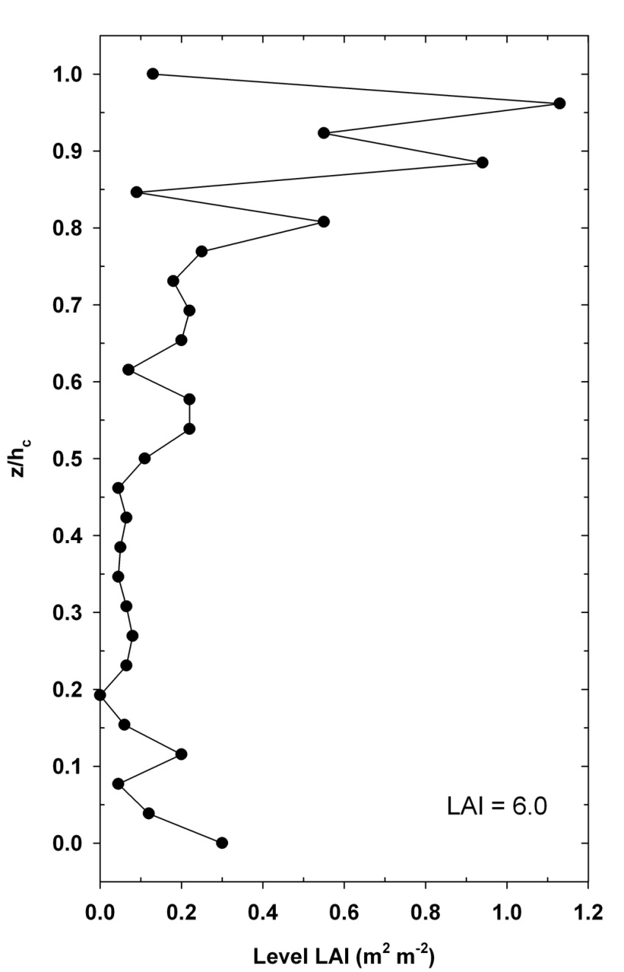
Application of ACCESS to Walker Branch Forest Canopy
Walker Branch Watershed Flux tower
35°57’30”N, 84°17’15”W; 365 m ASL
10 km SW of Oak Ridge, TN, on ORNL Reservation
Isoprene emission dominated canopy: Chestnut oak, tulip poplar, white oak, red oak, red maple, various hickory
Canopy morphology –
canopy height (26 m), LAI (6.0)
Vertical profile of leaf area density (LAD) from Hutchison et al. (1986).
Steady-state simulation for 4:00 pm on July 20, 1999, during field measurement intensive (Fuentes et al., 2007)
Experiment:
Sensitivity of results to NO_{x} level
Notes:
ORNL – Oak Ridge National Laboratory
- Hutchison et al. (1986) The architecture of a deciduous forest canopy in eastern Tennessee, U.S.A., Journal of Ecology, 74, 635-646.
- Fuentes et al. (2007) Biogenic hydrocarbon chemistry within and above a mixed deciduous forest, Journal of Atmospheric Chemistry, 56, 165-185.

Slide 19
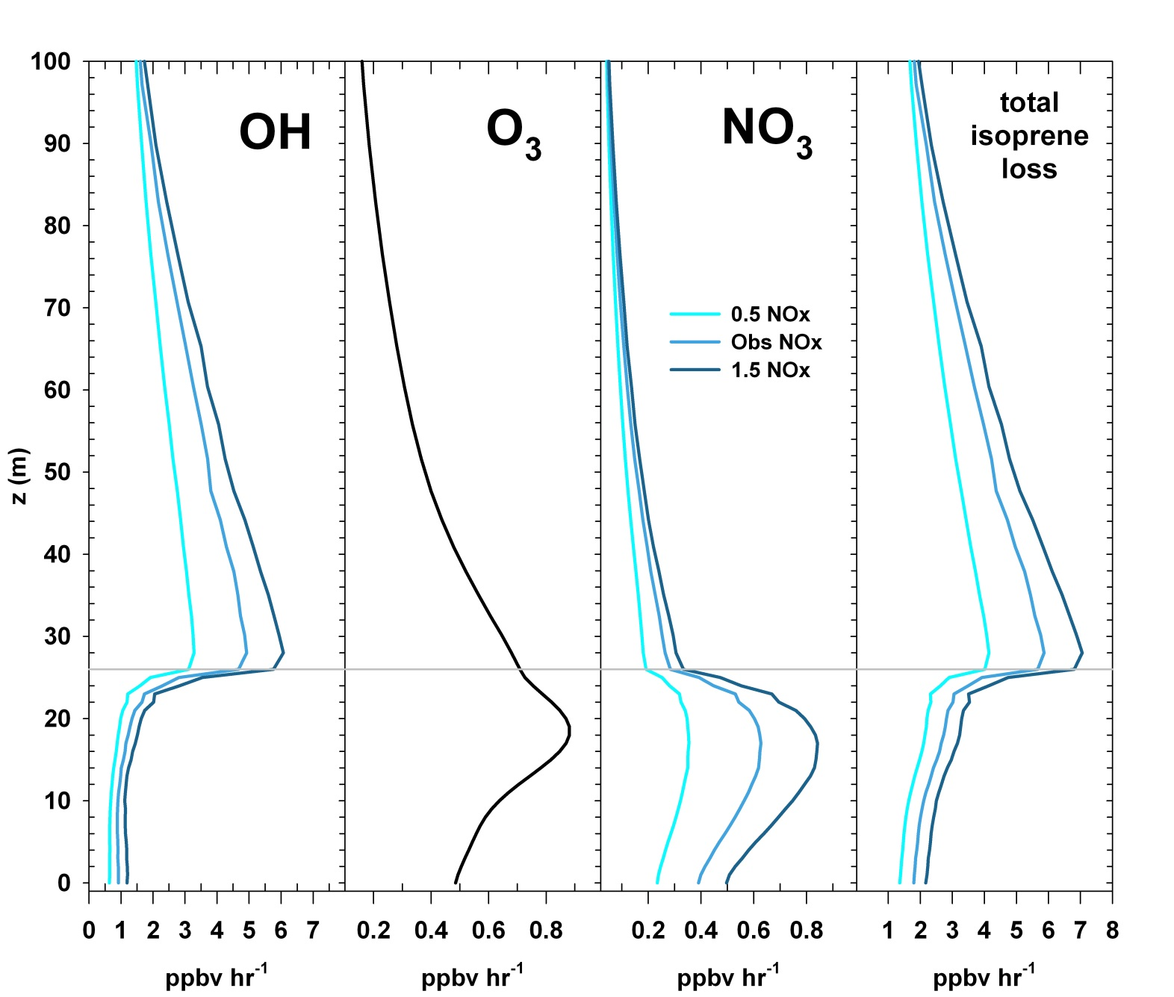
Differences in within-canopy versus above-canopy chemistry – not captured by large-scale air quality models
ARL Science Review, June 21-23, 2016
19
Notes:
Chemical loss (ppbv/hr) of isoprene via reaction with hydroxyl (OH) radicals, ozone (O3), and nitrate (NO3) radicals, and total chemical loss in the lowest 100 m of the model domain (domain extends from the ground surface to 2000 m). Horizontal gray line represents the height of the forest canopy. Chemical loss by ozone does not change with background NOx since O3 levels were constrained to observed values in this experiment.

Slide 20
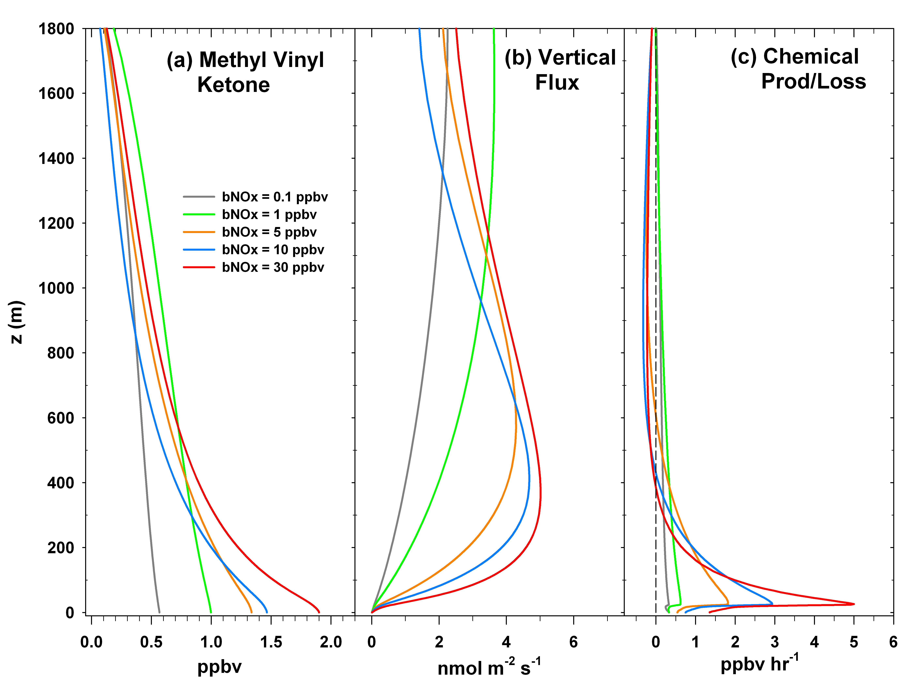
Effective fluxes of biogenic hydrocarbons are affected by ambient NO_{x} levels – not explicitly modeled by large-scale air quality models
Notes:
“Effective” flux refers to the vertical flux above the canopy, including emission, chemical reactions, deposition and vertical turbulent transport. Methyl vinyl ketone (MVK) is a first-generation oxidation product of isoprene.

Slide 21
Effective fluxes of biogenic aerosol precursors change with ambient NO_{x}
Notes:
“Effective” flux refers to the vertical flux above the canopy, including emission, chemical reactions, deposition and vertical turbulent transport. Methyl glyoxal and methacryloyl peroxy nitrate (MPAN) are higher generation isoprene oxidation products. Horizontal gray line denotes the height of the forest canopy.

Slide 22
Notes:
ACCESS-NH3 – the Atmospheric Chemistry and Canopy Exchange Simulation System for Ammonia. Ammonia concentration and flux measurements occurred during the entire growing season over a maize canopy near Bondville, IL, in 2014. Ammonia (NH3) is an important trace species which affects the formation of atmospheric aerosol particles via reactions with atmospheric acids (primarily sulfuric and nitric) to form solid ammonium salts.

Slide 23
Notes:
Bi-directional fluxes of ammonia above a fertilized agricultural field are affected by soil fluxes after fertilization, interactions with the crop canopy, and fluxes of ammonia from remote sources.

Slide 24
ACCESS-NH3 Simulation – Bondville, IL
Aug 30, 2014
Notes:
Results from an ACCESS-NH3 simulation for August 30, 2014, as compared to measured ammonia fluxes (ng/sq m-s) Fnet is the net above-canopy flux; Fg is the flux ground level from the soil; Fs is the net flux from/to the canopy stomata; and, Fw is the net flux from/to the canopy leaf surface; and Fc is the net canopy flux. An upward flux is positive. Gamma-g is the soil emission potential and Gamma-s is the stomatal emission potential.

Slide 25
ACCESS-NH3 Simulation – Bondville, IL
Aug 30, 2014
Notes:
Time progression of the canopy source/sink function for two ACCESS-NH3 simulations of Bondville data on August 30, 2014, using different combinations of the soil and stomatal emission potentials. Future work will use within canopy measurements to better understand how the canopy responds as an ammonia source or sink as a function of environmental conditions.

Slide 26
Particle Dry Deposition Parameterizations
Dry deposition is an important process for surface PM_{2.5}
Collaboration with Barry Baker (HQ), Bruce Hicks (ret NOAA; Metcorps), and Pius Lee, Daniel Tong and others (HQ)
ARL Science Review, June 21-23, 2016
26
Notes:
Results from a Process Analysis simulation of the CAMx (v6.0) air quality modeling system for a domain over the southeastern U. S. in June 2013. The y-axis shows process contributions to simulated surface layer PM2.5 concentrations. aqchem – aqueous chemistry; chem – gas-phase chemistry; ddep – dry deposition; emis – area emissions; ptemis – point source emissions; wdep – wet deposition.

Slide 27
Particle Dry Deposition Parameterizations
Many particle dry deposition algorithms, none of which agree closely with measurements over forest canopies
Saylor et al. (2015); Hicks et al. (2016)
ARL Science Review, June 21-23, 2016
27
Notes:
Figure from Hicks et al. (2016). Model results shown as solid lines; observations as symbols.
Saylor et al. (2015) A Comparison of Particle Dry Deposition Algorithms in Air Quality Models, 17th Community Modeling and Analysis System Annual Conference, Chapel Hill, NC, October 5-7.
Hicks et al. (2016) Dry deposition of particles to canopies – A look back and the road forward, submitted to Journal of Geophysical Research, in review.

Slide 28
Particle Dry Deposition Sensitivity Study
CAMx v6.00
NAQFC NMMB
NAQFC Emissions
CB05 Chemistry
8 Bin CMU sectional Aerosols
26 Land Use Types
4km Horizontal Resolution
308x244 grid cells
22 vertical layers
PPM Advection
EBI Chemistry
Simulation Period: June 10th -July 1st, 2013
Southern Atmosphere Study
SENEX (NOAA) and SOAS (NSF & USEPA)
Notes:
Land use data at 4 km horizontal resolution for the simulation domain during the 2013 Southern Atmosphere Study. All forest land use types are represented in shades of green.
CAMx – Comprehensive Air Quality Model with Extensions, v6.00, Ramboll ENVIRON, Novato, CA.

Slide 29
CAMx – June 14th – June28th, 2013 – PM_{2.5} Deposition (g/ha)
Notes:
Total PM2.5 deposition (g/ha) for four simulations using different particle deposition algorithms. Zhang et al. (2001) is one the default algorithms available in CAMx v6.0. The three other results are presented as _deltas_ from the Zhang et al. (2001) result.
Zhang et al. (2001) A size-segragated particle dry deposition scheme for an atmospheric aerosol module, Atmospheric Environment, 35, 549-560.
Pleim & Ran (2011) Surface flux modeling for air quality applications, Atmosphere, 2, 271-302, doi:10.3390/atmos2030271.
Petroff & Zhang (2010) Development and validation of a size-resolved particle dry deposition scheme for application in aerosol transport models, Geoscientific Model Development, 3, 753-769.
The “Empirical” simulation uses the Zhang et al. (2001) algorithm as a base, but forces particle deposition velocities to better represent observations (as presented in Slide 27) for all forest land use types.

Slide 30
CAMx – June 14th – June 28th, 2013 – PM_{2.5} (μg/m³) and % Difference
Notes:
Surface PM2.5 concentration for the four sensitivity simulations. The default Zhang et al. (2001) result is presented as ug/m3; results from the other three algorithms are presented as percentage differences from Zhang et al. (2001) for ease of comparison.

Slide 31
Quality and Performance
Saylor, R., and Hicks, B. (2016) Time for a new approach to modeling surface-atmosphere exchanges in air quality models?, Atmos. Environ., 129, 229-233.
Saylor, R., Myles, L., Sibble, D., Caldwell, J., Xing, J. (2015) Recent trends in gas-phase ammonia and PM_{2.5} ammonium in the Southeast United States, J. Air & Waste Manage. Assoc., 65, 347-357.
Tong, D. Q., Lei, H., Pan, Li., Chai, T., Kim, H., Lee, P., Saylor, R., Wang, M., Kondragunta, S. (2014) Assimilation of satellite oceanic and atmospheric products to improve emission forecasting, Air Pollution Modeling and its Application XXIII, D. Steyn and R. Mathur, Eds. Springer International Publishing, Switzerland.
Saylor, R. D., Wolfe, G. M., Meyers, T. P., Hicks, B. B. (2014) On a corrected formulation of the multilayer model (MLM) for inferring dry deposition to vegetated surfaces, Atmos. Environ. 92, 141-145.
Saylor, R. D (2013) The Atmospheric Chemistry and Canopy Exchange Simulation System (ACCESS): Model description and application to a temperate deciduous forest canopy, Atmos. Chem. Phys., 13, 693-715.
Stein, A. F., R. D. Saylor (2012) Sensitivities of sulfate aerosol formation and oxidation pathways on the chemical mechanism employed in simulations, Atmos. Chem. Phys., 12, 8567-8574.
Tong, D. Q., P. Lee, R. D. Saylor (2012) New Directions: The need to develop process-based emissions models, Atmos. Environ., 47, 560-561.
Saylor, R. D., A. F. Stein (2012) Identifying the causes of differences in ozone production from the CB05 and CBMIV mechanisms, Geoscientific Model Development, 5, 257-268.
Notes:
Results from the research are regularly published in the peer-reviewed literature and translated to NAQFC as appropriate.

Slide 32
Future Directions
Continued development of ACCESS
Updated biogenic hydrocarbon emissions and chemistry
Updated canopy physics
Addition of aerosol phase
Translation of ACCESS results to air quality models (NAQFC)
Evolution of ACCESS into a surface-atmosphere exchange module (Saylor and Hicks, 2016)
Notes:
ACCESS will be included in the Canopy Exchange Model Intercomparison Project (CANEXMIP), organized by the Integrated Land-Ecosystem-Atmosphere Processes Study (iLEAPs), a core project of the International Geosphere-Biosphere Program (IGBP). CANEXMIP will begin at the 2016 International Global Atmospheric Chemistry (IGAC) Science Conference in Breckenridge, CO, during September.

Slide 33
Future Directions
Continued development of ACCESS
Updated BVOC emissions and chemistry
Updated canopy physics
Addition of aerosol phase
Translation of ACCESS results to air quality models (NAQFC)
Evolution of ACCESS into a surface-atmosphere exchange module (Saylor and Hicks, 2016)

Slide 34
Future Directions
Continued development of ACCESS
Updated BVOC emissions and chemistry
Updated canopy physics
Addition of aerosol phase
Translation of ACCESS results to air quality models (NAQFC)
Evolution of ACCESS into a surface-atmosphere exchange module (Saylor and Hicks, 2016)
Notes:
Saylor and Hicks (2016) New Directions: Time for a new approach to modeling surface-atmosphere exchanges in air quality models?, Atmospheric Environment, 129, 229-233.

Slide 35
Saylor and Hicks (2016) Atmos. Environ. 129, 229-233.
Notes:
Current air quality/atmospheric chemistry models treat biogenic emissions and dry deposition as completely separate model processes, even though evidence has accumulated over time that emissions and deposition are often two sides of the same coin for many important chemical trace species. Evolution to the incorporation of a surface-atmosphere exchange module will allow for a more physically, chemically and biologically consistent representation of surface-atmosphere exchange in air quality/atmospheric chemistry models.

Slide 36
Questions?

Slide 37
CAMx – June 14th – June28th, 2013 – Mean Deposition Velocity 0.5-12 μm (cm/s)

Slide 38
CAMx – June 14th – June28th, 2013 – Total PM_{2.5} Deposition (g/ha)

Slide 39
CAMx – June 14th – June 28th, 2013 – Mean Surface PM_{2.5} (μg/m³)

